Slide 1
Risk prediction modelling of Alzheimer’s Disease: biomarkers and PRS
Valentina Escott-Price, Emily Simmonds
Cardiff University, UK
EMBL-EBI Cambridge, 10 April 2024

Slide 2
Outline
AD and age
APOE and age
AD PRS and age
AD biomarkers and age
AD heritability and age

Slide 3
AD and age
Dementia is primarily a disease of aging, with prevalence rates of dementia much higher in older age groups.
The most common form of dementia is Alzheimer’s disease, accounting for around 62% of cases.
The pathologic definition of both disease and controls is different at different ages with a clear pathologic separation between cases and controls when both are below 65 but almost no separation between cases and controls at the age of 90.

Slide 4
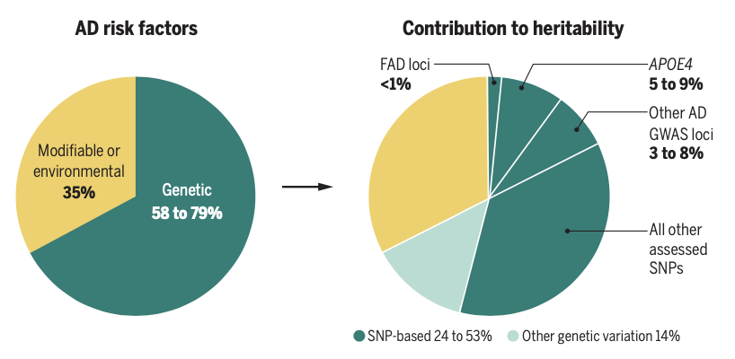
Heritability of Alzheimer’s Disease
Definition: the proportion of heritability explained by a set of variants to the total heritability.
Sierksma A, Escott-Price V, De Strooper B. (2020) Translating genetic risk of Alzheimer’s disease into mechanistic insight and drug target. Science 370:61–66.

Slide 5
AD heritability and age
The heritability of late onset Alzheimer’s Disease liability is generally agreed to be around 60% from twin studies.
An individual’s genetic loading for AD remains the same at any age, but the prevalence of AD is dependent on age.
Both Alzheimer’s disease (AD) and ageing have a strong genetic component.

Slide 6
AD genome-wide association studies

Slide 7
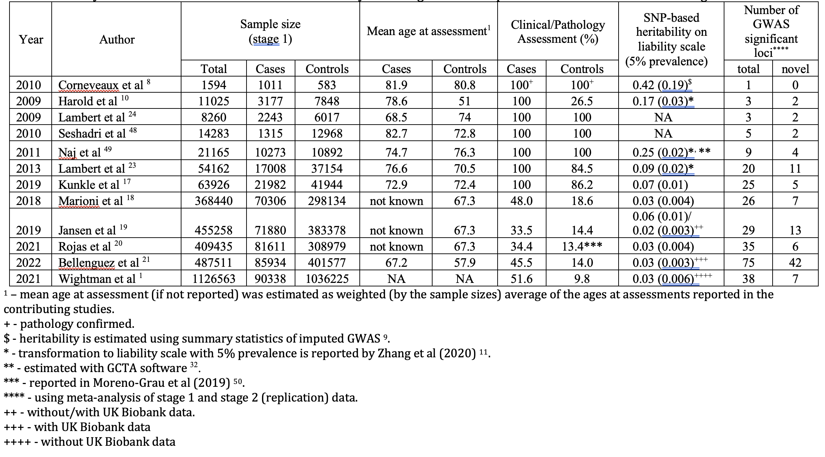
History of AD GWAS and their SNP-based heritability assuming 5% disease prevalence

Slide 8
Escott-Price V and Hardy J (2022) Genome Wide Association Studies for Alzheimer’s Disease: bigger is not always better. Brain Communications

Slide 9
APOE and AGE

Slide 10
Heritability with GCTA
Data | Demographics | Cases | Controls
ADC (Amyloid confirmed) | N | 1134 (CSF) | 1978
 | Age at interview [SD] | 65.4 [7.6] | 62.0 [14.5]
 | Sex [M/F] | 540/594 | 1031/947
(B) GR@ACE | N | 4113 | 3283
 | Age at onset/interview [SD] | 79 [7.5] | 54.5 [14.0]
 | Sex [M/F] | 1256/2856 | 1676/1605
(C) KRONOS/Tgen | N | 994 | 572
 | Age of death [SD] | 81.9 [8.7] | 81 [8.8]
 | Sex [M/F] | 361/633 | 355/217
(D) ADC | N | 851 (clinical) | 1978
 | Age at interview [SD] | 72.8 [10.3] | 62.0 [14.5]
 | Sex [M/F] | 373/478 | 1031/947
(E) ROSMAP/MSBB/MAYO | N | 358 | 445
 | Age of death [SD] | 85.9 [6.0] | 84.5 [6.2]
 | Sex [M/F] | 100/258 | 167/278
(F) UKBB | N | 2528 | 10,000
 | Age at interview [SD] | 76.8 [4.3] | 75.2 [3.3]
 | Sex [M/F] | 1227/1301 | 4706/5294
Baker E, Leonenko G , Schmidt KM, Hill M , Myers AJ, Shoai M, de Rojas I, Tesi N, Holstege H, van der Flier WM, Pijnenburg YAL, Ruiz A, Hardy J, van der Lee S, Escott-Price V (2023) What does heritability of Alzheimer's disease represent? PLoS One.28;18(4):e0281440.

Slide 11
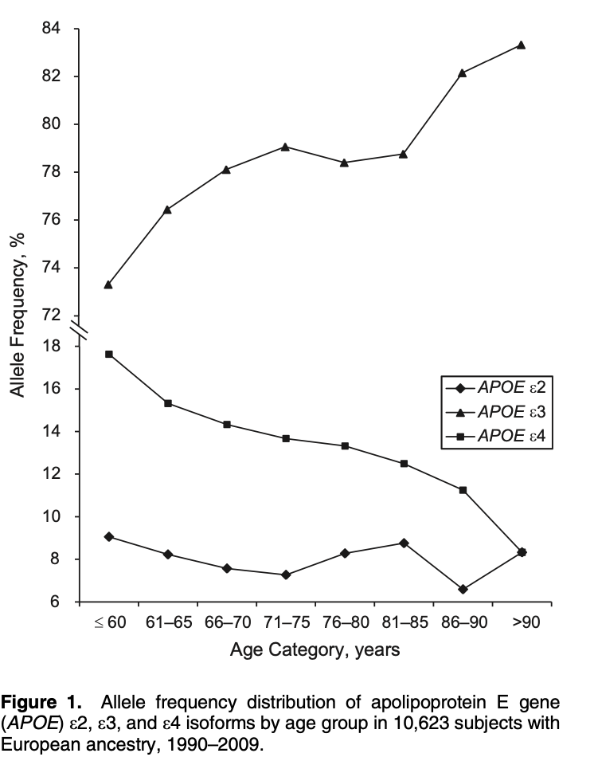
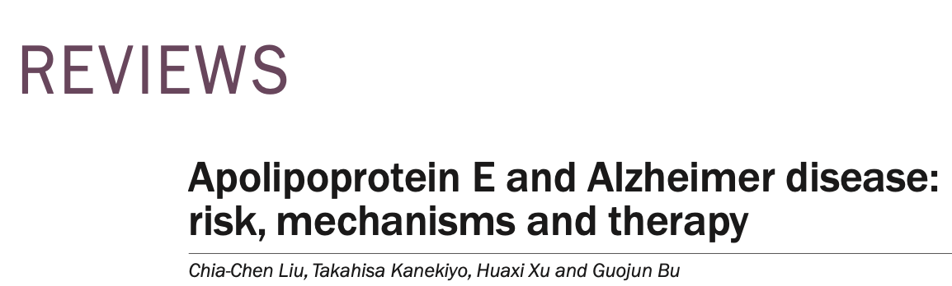
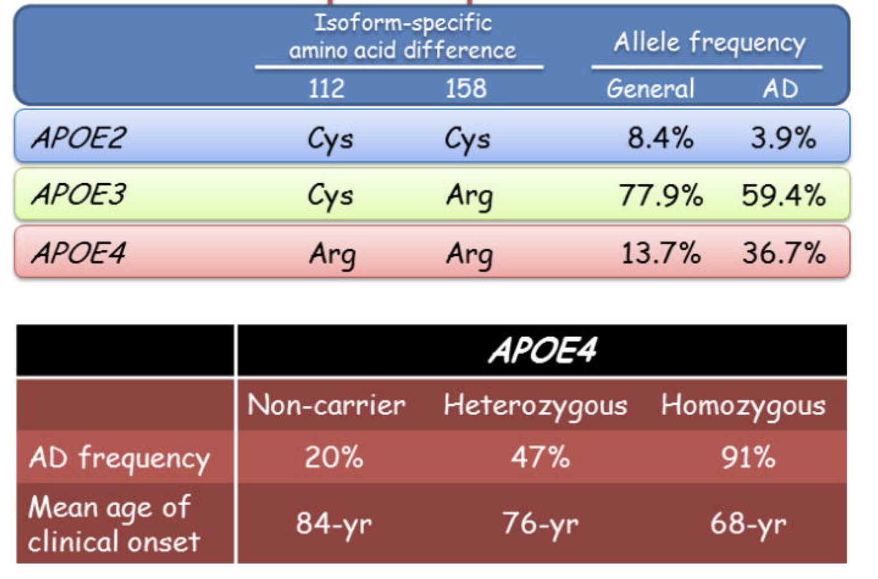
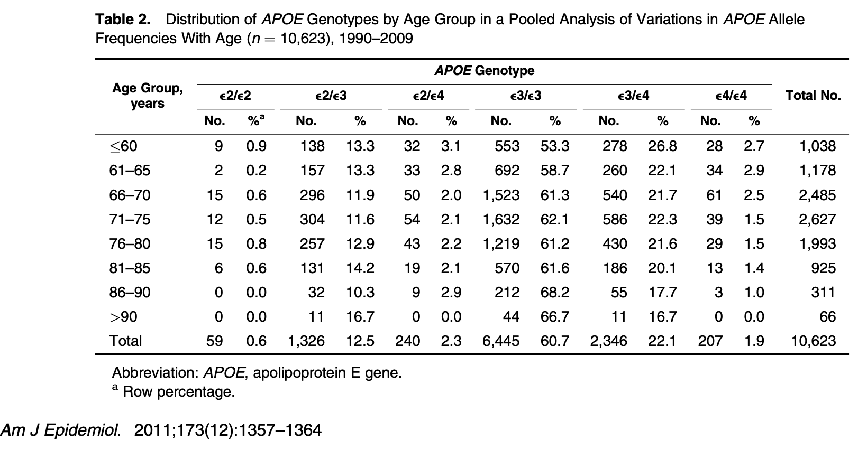
Liu, C.-C. et al. Nat. Rev. Neurol. 9, 106–118 (2013); published online 8 January 2013; corrected online 26 February 2013; doi:10.1038/nrneurol.2012.263
Notes:
Having in mind that the cases and controls where we calculated and assessed the PRS was age matched (another path confirmed), where the most recent studies tend to include population (hence younger) controls and/or cases defined via the family history (UKBB proxies).

Slide 12
AD genetic architecture and AGE
Very early AD cases (aged 30-50) are mostly attributed to rare highly penetrant mutations in APP and PSEN genes. The disease prevalence at this age in the population is then close to the frequencies of these risk alleles (<1%).
e44 carriers have age at onset of about 68, and the disease prevalence at this age is likely to be around or slightly larger than e44 frequency (~2-3%), due to the variation in the age at onset of e4 heterozygotes and non-carriers.
The mean age of clinical onset of e4 non-carriers is ~84 years of age. The disease prevalence at this age is reported as something between 17-32%. The disease at this age is likely to be attributed to a large number of common SNPs associated with a variety of disease development mechanisms, including comorbid disorders.
The genetic architecture of AD is different depending on age at clinical onset.

Slide 13
PRS and AGE

Slide 14
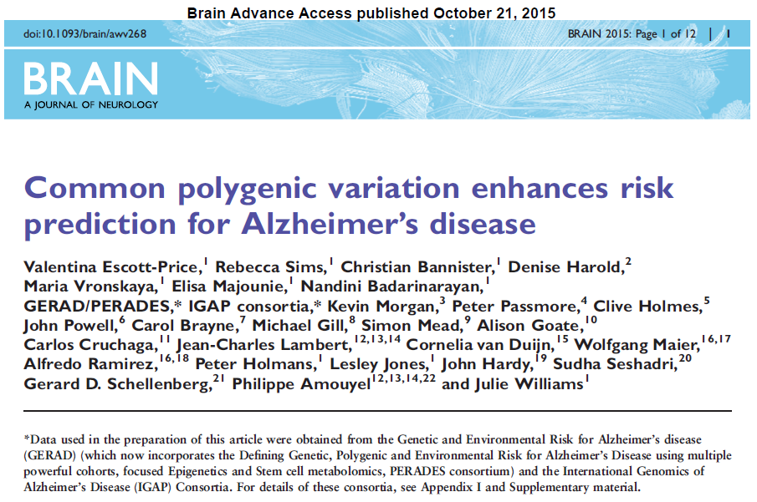
Predictive accuracy for 3,049 AD cases vs 1,554 controls.
PRS were constructed using independent SNPs associated with AD GWAS (13,831 cases, 29,877 controls) at different significance levels (MODEL column), excluding APOE and 20 GWAS regions.
MODEL | Sensitivity & Specificity |  | Specificity | Improvement over APOE | Improvement over APOE & GWAS
ε4 | 0.593 |  | 0.746 | - | -
ε4 + ε2 | 0.593 |  | 0.746 | - | -
e4 + e2 + sex + age | 0.669 |  | 0.662 | 8.5x10⁻¹³ | -
e4 + e2 + 20 GWAS SNPs | 0.666 |  | 0.666 | 2.7x10⁻¹² | -
e4 + e2 + 20 GWAS SNPs + PRS p<0.0001 | 0.669 |  | 0.669 | 2.5x10⁻¹⁴ | 0.048
e4 + e2 + 20 GWAS SNPs + PRS p<0.001 | 0.668 |  | 0.668 | 2.8x10⁻¹⁶ | 0.0082
e4 + e2 + 20 GWAS SNPs + PRS p<0.01 | 0.672 |  | 0.672 | 1.1x10⁻²¹ | 9.5x10⁻⁶
e4 + e2 + 20 GWAS SNPs + PRS p<0.05 | 0.677 |  | 0.677 | 7.4x10⁻²⁷ | 3.6x10⁻⁹
e4 + e2 + 20 GWAS SNPs + PRS p<0.1 | 0.682 |  | 0.682 | 3.5x10⁻²⁸ | 5.9x10⁻¹⁰
e4 + e2 + 20 GWAS SNPs + PRS p<0.2 | 0.683 |  | 0.683 | 1.5x10⁻²⁹ | 3.6x10⁻¹¹
e4 + e2 + 20 GWAS SNPs + PRS p<0.3 | 0.684 |  | 0.683 | 2.0x10⁻²⁹ | 3.9x10⁻¹¹
e4 + e2 + 20 GWAS SNPs + PRS p<0.4 | 0.684 |  | 0.684 | 1.1x10⁻²⁹ | 2.1x10⁻¹¹
e4 + e2 + 20 GWAS SNPs + PRS p<0.5 | 0.686 |  | 0.686 | 7.2x10⁻³⁰ | 1.3x10⁻¹¹
e4 + e2 + 20 GWAS SNPs + PRS p<0.6 | 0.685 |  | 0.685 | 4.4x10⁻³⁰ | 9.4x10⁻¹²
e4 + e2 + 20 GWAS SNPs + PRS p<0.7 | 0.685 |  | 0.685 | 1.0x10⁻²⁹ | 1.7x10⁻¹¹
e4 + e2 + 20 GWAS SNPs + PRS p<0.8 | 0.683 |  | 0.683 | 6.2x10⁻³⁰ | 1.2x10⁻¹¹
e4 + e2 + 20 GWAS SNPs + PRS p<0.9 | 0.684 |  | 0.684 | 6.3x10⁻³⁰ | 1.2x10⁻¹¹
e4 + e2 + 20 GWAS SNPs + PRS p<0.5 + age + sex | 0.704 |  | 0.703 | 1.9x10⁻⁵⁷ | 6.5x10⁻³³

Slide 15
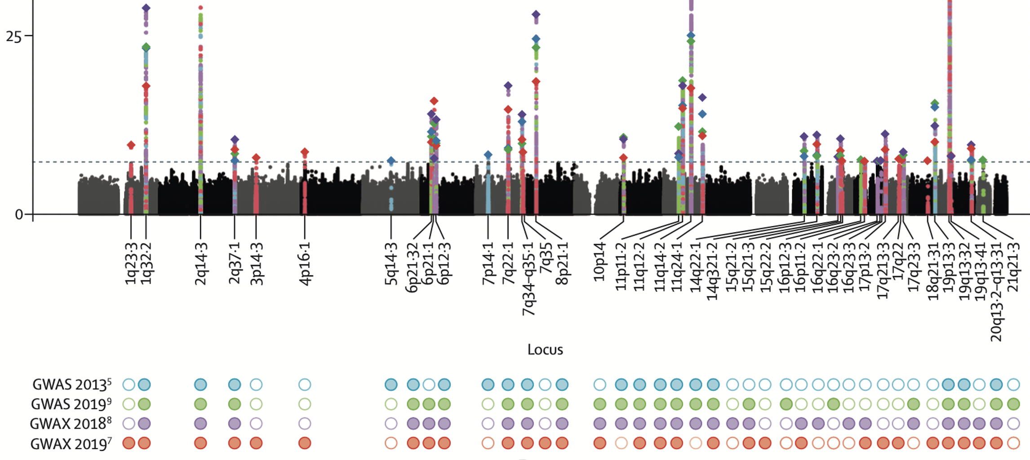
Disease models
Disease model
Polygenic
MODEL | N SNPs
e4 | 1
e4 + e2 | 2
e4 + e2 + sex + age | 2
e4 + e2 + 20 GWAS SNPs | 22
e4 + e2 + 20 GWAS SNPs + PRS p<0.0001 | 130
e4 + e2 + 20 GWAS SNPs + PRS p<0.001 | 549
e4 + e2 + 20 GWAS SNPs + PRS p<0.01 | 3388
e4 + e2 + 20 GWAS SNPs + PRS p<0.05 | 13273
e4 + e2 + 20 GWAS SNPs + PRS p<0.1 | 23676
e4 + e2 + 20 GWAS SNPs + PRS p<0.2 | 42273
e4 + e2 + 20 GWAS SNPs + PRS p<0.3 | 58963
e4 + e2 + 20 GWAS SNPs + PRS p<0.4 | 73941
e4 + e2 + 20 GWAS SNPs + PRS p<0.5 | 87605
e4 + e2 + 20 GWAS SNPs + PRS p<0.6 | 99724
e4 + e2 + 20 GWAS SNPs + PRS p<0.7 | 110431
e4 + e2 + 20 GWAS SNPs + PRS p<0.8 | 119616
e4 + e2 + 20 GWAS SNPs + PRS p<0.9 | 127585
e4 + e2 + 20 GWAS SNPs + PRS p<0.5 + age + sex | 87605
Oligogenic
Zang et al (2020), Nat Comm

Slide 16
Sample of screened aged matched or path-confirmed 271 cases and 278 controls
(a subsample of ADNI and AD-AMP excluding overlap with Kunkle et al (2019))
Leonenko, Baker et al (2021). Identifying individuals with high risk of Alzheimer’s Disease using PRS is most accurate when using all genetic information. Nature Communications, 12: 4506

Slide 17
Association results between disease status and polygenic risk scores in ADNI dataset
 |  | APOE (ε4+ε2) |  |  |  | PRS (excl. APOE region) (p_{T}≤0.5) |  |  |  | APOE + PRS (p_{T}≤0.5)
Age | N | β | SE | P | AUC | β | SE | P | AUC | P | AUC
< 80 | AD=87 NL=125 | 1.151 | 0.194 | 3.01x10⁻⁹ | 0.744 | 0.677 | 0.169 | 1.99x10⁻⁵ | 0.677 | 1.75x10⁻¹⁰ | 0.798
≥ 80 | AD=87 NL=99 | 0.780 | 0.174 | 7.08x10⁻⁶ | 0.667 | 1.456 | 0.229 | 1.9x10⁻¹⁰ | 0.811 | 7.04x10⁻¹¹ | 0.825
The models were adjusted for PCs, participants’ age at last assessment and sex. Genetic variants with p-value p_{T}≤ 0.5 from Kunkle et al (2019) summary statistics were used to calculate the genetic score.
Key: N, sample size; APOE, Apolipoprotein E; p_{T,} p-value with threshold T≤0.5; PRS, Polygenic Risk Score; excl., excluding; β, beta coefficient (effect size); SE, Standard Error; P, P-value; AUC, Area Under the Curve; AD, Alzheimer’s Disease; NL, Non-Demented/controls. Logistic regression was performed.
Bellou E, Baker E, Leonenko G, Bracher-Smith M, Daunt P, Menzies P, Williams J, Escott-Price V (2020) Age-dependent effect of APOE and polygenic component on Alzheimer’s disease. Neurobiology of Aging, 10.1016/j.neurobiolaging.2020.04.024

Slide 18
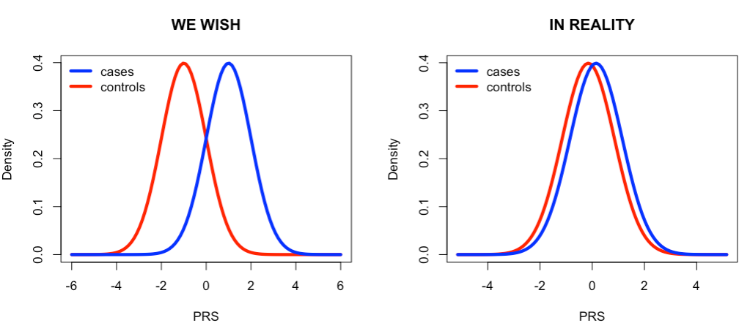
Polygenic risk score: theory and practice
$${ PRS}_{i}=\sum_{k=1}^{M}{β_{k}∙n_{{SNP}_{k}}^{(i)}}$$
PRS_{i} – Polygenic Risk Score for individual i (i=1,…, N)
M – number of (independent) SNPs (e.g. with p<0.1)
$n_{{SNP}_{k}}^{(i)}$– number of risk alleles (0,1, or 2) of SNP_{k} for individual i (k=1,…,M)
IN PRACTICE
Notes:
This inspired us to look at the PRS component. PRS is defined as accumulation of Risk alleles, which an individual carriers. Each SNP contribution is weighted by the SNP effect size obtained from an independent study.

Slide 19
PRS calculation (main) approaches
PRS(C+T), PRSice
LD-pruned with PLINK by retaining the variant with the smallest p-value from each LD block and excluding variants with r2 > 0.1 in 1000-kb window. PLINK was then used to construct the PRSs for each participant using as significance threshold the p-value p_{T} ≤ 0.1
https://choishingwan.github.io/PRSice/
PRS-CS (1000G and UKBB), Ge et al (2019) Nat Commun
PRS-CS utilizes a high-dimensional Bayesian regression framework by placing a continuous shrinkage (CS) prior on effect sizes, which is robust to varying genetic architectures, and enables multivariate modelling of local LD patterns
quickPRS, Zhang et al (2021) Nat Commun
A quick version of MegaPRS (LDAK and BayesR-SS), which does not assume that SNPs are contributing equally to the heritability of a trait (as compared to the previous models like GCTA and LDSC)

Slide 20
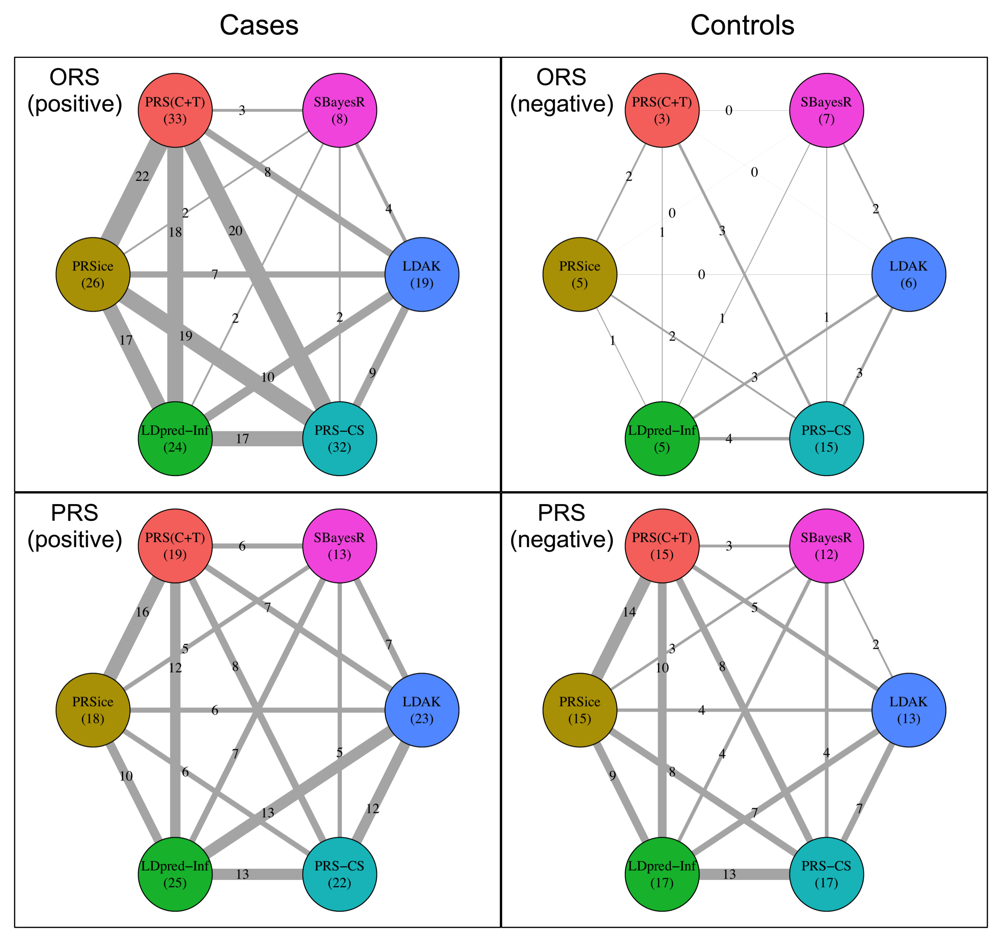
PRS consistency… (ADNI dataset)
Leonenko et al (2021), Nat Communications

Slide 21
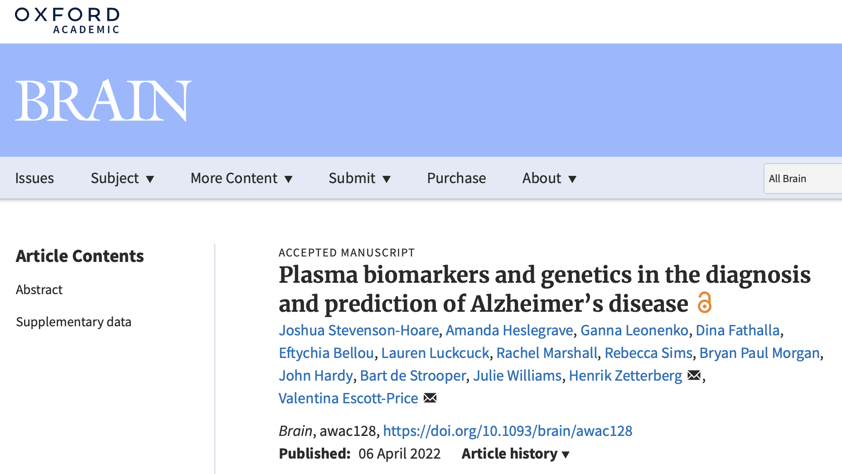
AD Biomarkers and AGE

Slide 22
Biomarkers
Aβ40, Aβ42 Aβ42/Aβ40 | free amyloid β proteins of chain length 40 and 42, ratio which normalizes high and low Aβ producers
GFAP | glial fibrillary acidic protein, marker of astrocyte proliferation
NfL | neurofilament light, marker of neurodegeneration and neuronal injury
Ptau-181 | tau protein phosphorylated at position 181, marker of tau pathophysiology and amyloid plaque deposition
Blood plasma was collected, and biomarker levels were measured using ‘Simoa’
(Single Molecule Analysis, Quanterix, MA) by Prof Zetterberg’s lab (DRI at UCL)

Slide 23
What is known about biomarkers?
AB40 and AB42 are reduced in AD dementia compared to MCI patients and healthy controls¹
GFAP and NfL levels in CSF and plasma are higher in AD, and correlate with cognitive impairment²
Plasma Ptau-181 predicts AD disease pathology eight years before autopsy³
¹Janelidze et al. (2016) Science Reports
²Verbek et al. (2021) Lancet: Health and Longevity
³Lantero Rodriguez et al. (2020) Acta Neuropathologica
and many more…

Slide 24

Biomarkers over time
As AD pathology progresses, biological markers for those pathologies reflect this.
Some AD pathologies are also seen in normal aging at lesser rates, so biomarkers may also change with normal aging.
Abnormal changes in biomarkers in healthy individuals may indicate incipient AD, before clinical assessment can detect cognitive impairment.

Slide 25
Sampled Individuals
Alzheimer’s Disease Cardiff Cohort, collected between 2004 and 2020
 | Controls | Cases
Age [SD] | 82.2 [6.72] | 68.1 [8.03]
Sex M / F | 221 / 287 | 748 / 691
Age at onset | N/A | 62.4 [7.9]
Duration | N/A | 5.3 [3.6]
1947 Total individuals
1439 AD cases
508 Elderly screened controls

Slide 26
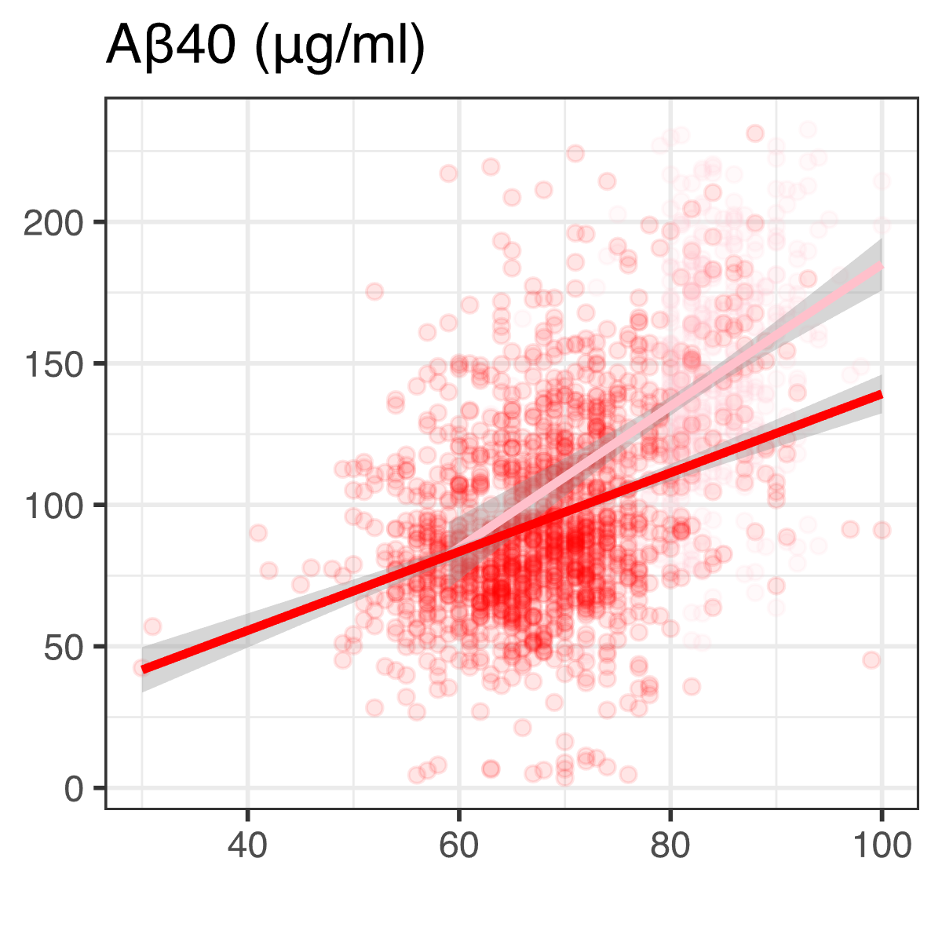
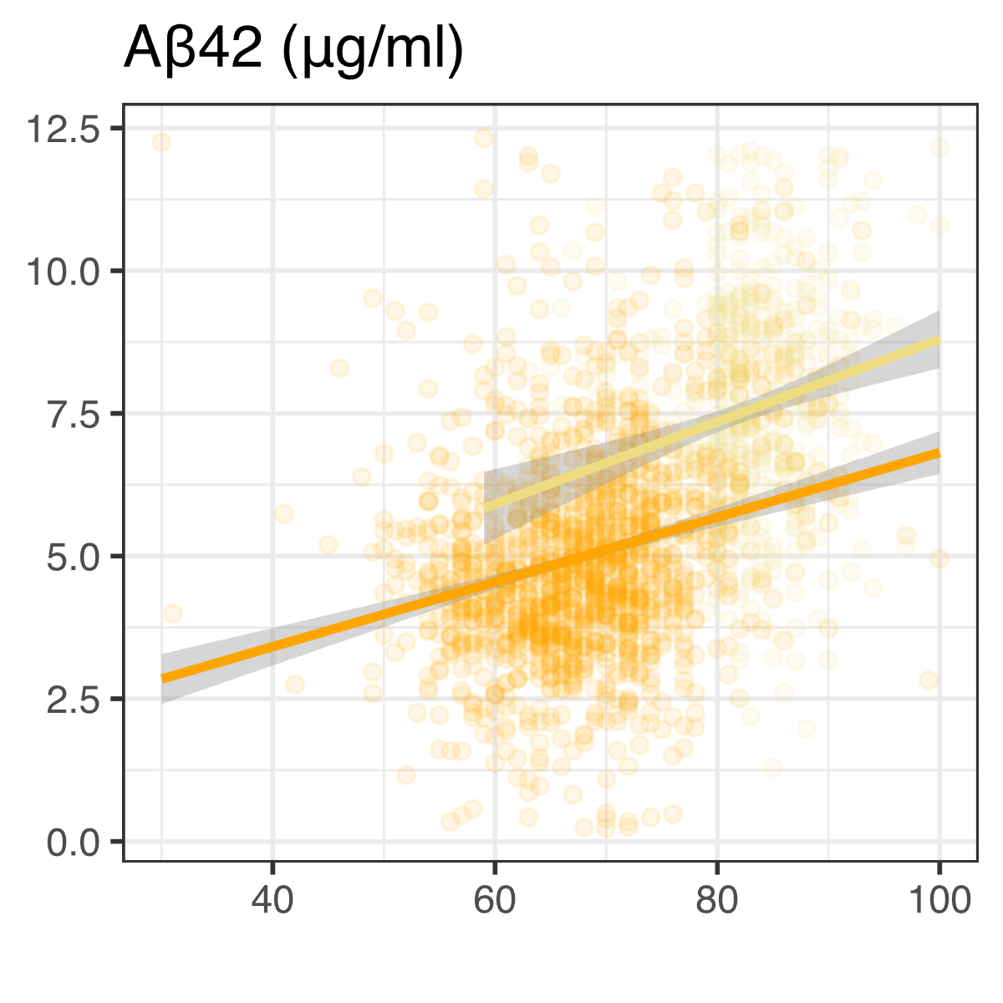
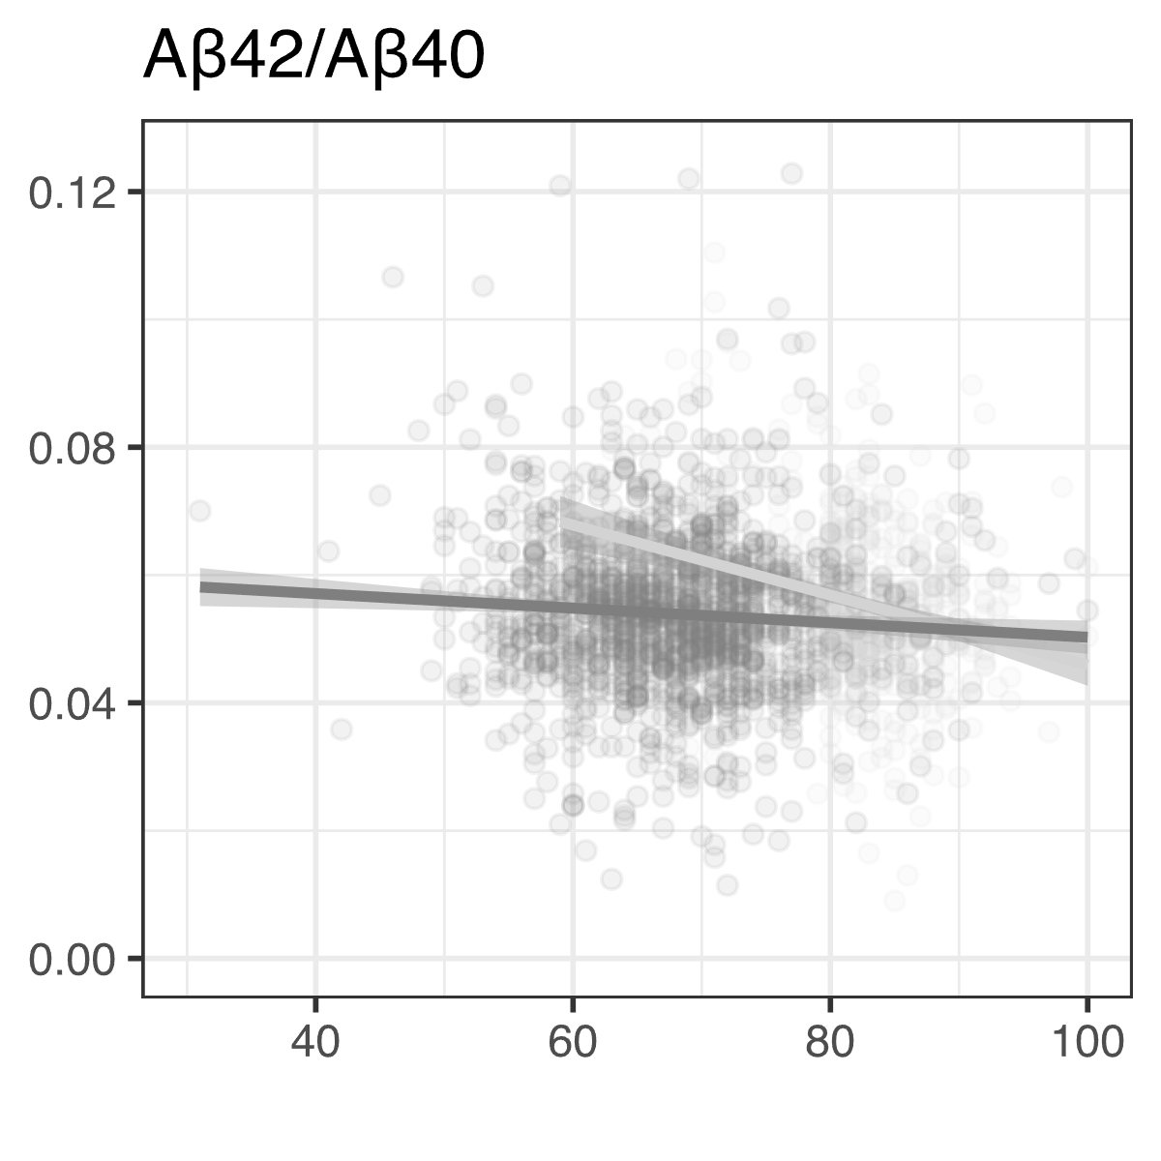
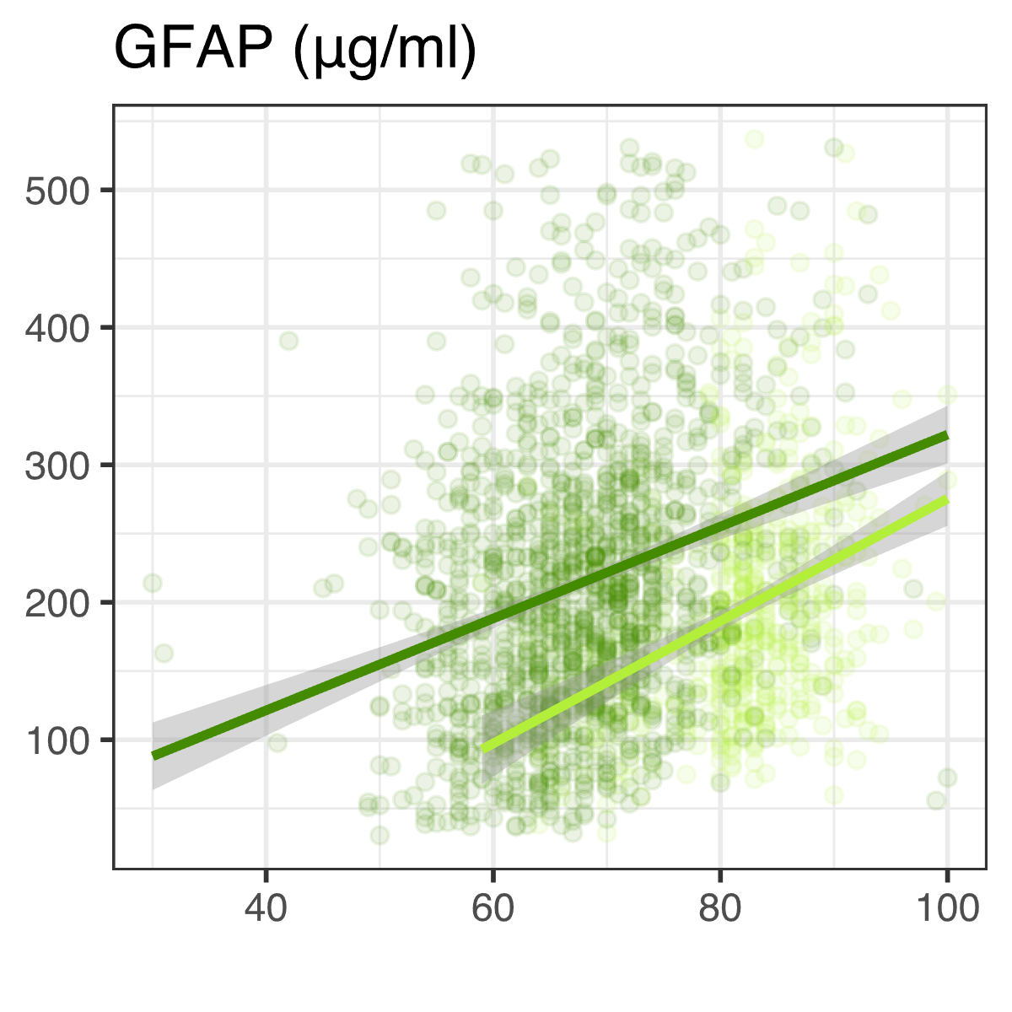
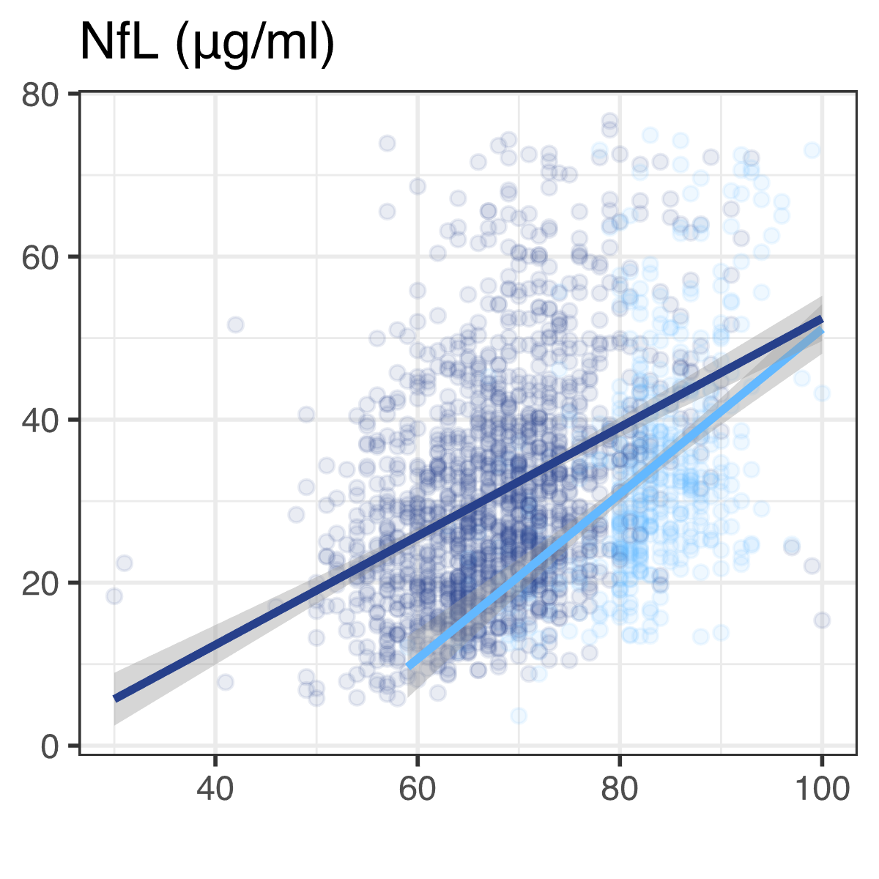
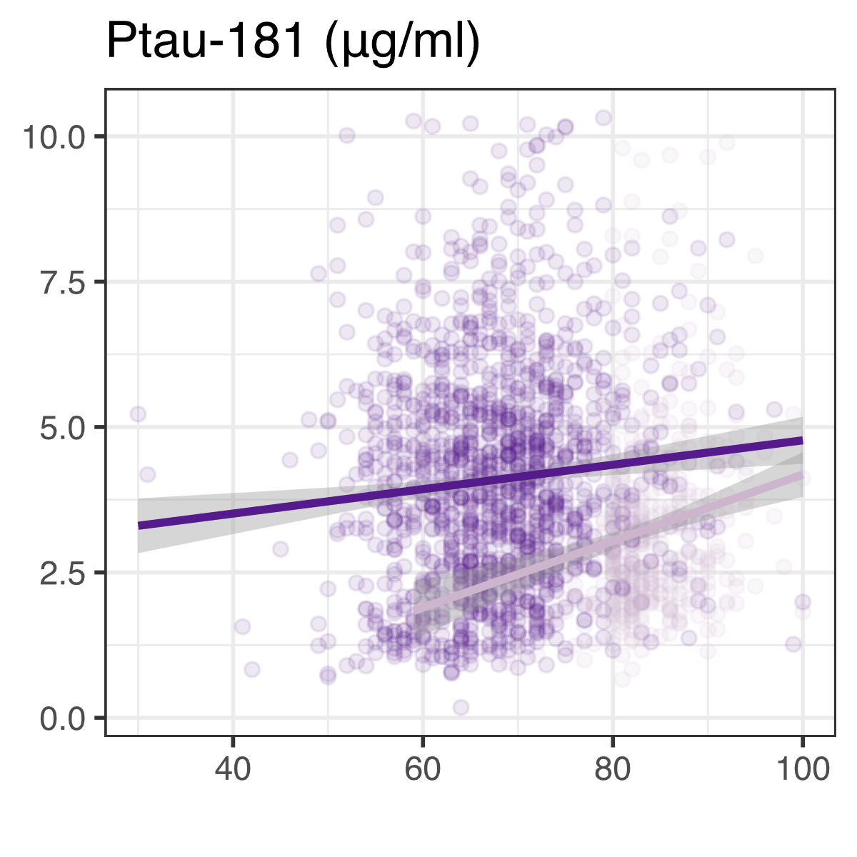
Predicting biomarkers from Age (Linear regressions controlling for sex, standardised predictors)
Young cases look like elderly controls
Age is a significant predictor of biomarker levels in both cases and controls
Cases B=0.041
Controls B=0.064
Cases B=0.034
Controls B=0.036
Cases B= -0.010
Controls B= -0.044
Cases B=0.034
Controls B=0.052
Cases B=0.051
Controls B=0.074
Cases B=0.014
Controls B=0.038
All regressions were significant (p=0.0018 – 1.2x10⁻⁵⁴⁾

Slide 27
Predicting biomarkers in cases only Linear regressions using age at onset and disease duration, controlling for sex
 |  | Age at onset |  |  | Duration
 | N | B | SE | p | B | SE | p
Aβ40 | 1219 | 0.042 | 0.003 | 1.9x10⁻³⁵ | 0.016 | 0.007 | 0.027
Aβ42 | 1219 | 0.034 | 0.003 | 4.2x10⁻²³ | 0.013 | 0.007 | 0.077
Aβ42/Aβ40 | 1215 | -0.012 | 0.003 | 0.0005 | -0.004 | 0.008 | 0.592
GFAP | 1301 | 0.034 | 0.003 | 7.1x10⁻²⁴ | 0.034 | 0.007 | 2.9x10⁻⁶
NfL | 1275 | 0.048 | 0.003 | 1.1x10⁻⁴⁴ | 0.050 | 0.007 | 1.2x10⁻¹²
pTau-181 | 1309 | 0.011 | 0.003 | 0.0023 | 0.020 | 0.008 | 0.008
Biomarker levels can be predicted from age at onset and disease duration in cases
Most biomarkers are associated with age at onset over and above disease duration
GFAP and NfL are associated with disease duration, over and above age at onset
<biomarker> ~ Age at Onset + Disease Duration + Sex

Slide 28
Predicting AD status from biomarkers Logistic regressions controlling for age at sample collection and sex
 | B | SE | p | R² | AUC
Aβ40 | -0.44 | 0.058 | 3.5x10⁻¹⁴ | 0.05 | 0.63
Aβ42 | -0.56 | 0.059 | 2.8x10⁻²¹ | 0.08 | 0.66
Aβ42/Aβ40 | -0.18 | 0.055 | 0.0009 | 0.01 | 0.56
GFAP | 0.55 | 0.067 | 2.4x10⁻¹⁶ | 0.07 | 0.64
NfL | 0.47 | 0.066 | 1.1x10⁻¹² | 0.05 | 0.63
P-tau181 | 0.55 | 0.067 | 1.4x10⁻¹⁶ | 0.07 | 0.65
Regressions controlling for age and sex show that
AB40, AB42, GFAP, NfL, and P-tau181 are all strongly predictive of AD
AB42/AB40 ratio is less strongly predictive of AD
All biomarkers individually explain ~60% of variance in whether a person gets Alzheimer’s disease
Similar association patterns (Aβ42/Aβ40 is negatively associated with age) were reported
in a longitudinal study of memory and aging (Schindler et al (2019))

Slide 29
Combining biomarkers and genetics (Logistic and stepwise regression, biomarkers adjusted for age and sex)
 | Predictors | AUC | R²
All biomarkers combined | Aβ40 + Aβ42 + Aβ42/Aβ40 + GFAP + NfL + P-tau181 | 0.75 | 0.18
Genetic factors | PRSnoAPOE + APOEe2 + APOEe4 | 0.74 | 0.21
All biomarkers + genetics | Aβ40 + Aβ42 + Aβ42/Aβ40 + GFAP + NfL + Ptau-181 + PRSnoAPOE + APOEe2 + APOEe4 | 0.81 | 0.29
Stepwise regression | Aβ40 + Aβ42/Aβ40 + GFAP + NfL + PRSnoAPOE + APOEe2 + APOEe4 | 0.81 | 0.28
Biomarkers combined , adjusted for age and sex, achieve similar accuracy to genetics
Adding biomarkers improves prediction over and above genetics

Slide 30
Overall Findings
Using multiple biomarkers reflects different aspects of AD pathology.
Age at collection was significantly associated with biomarker levels.
Biomarkers were also associated with age at onset and disease duration in cases.
Biomarkers capture variation not captured by genetic factors and improve prediction models for AD.

Slide 31
In conclusion:
The diagnostic accuracy for Alzheimer’s disease is poor
Larger GWASes provide less reliable estimates resulting to smaller fraction of explained heritability
Blood plasma biomarkers can only be a useful tool for the assessment and prediction of Alzheimer’s disease in the context of other genetic and/or clinical information.
Since Alzheimer’s disease is a very common cause of age-related mortality, the choice of aged matched controls is essential
Longitudinal studies which use a combination of genetics, plasma biomarkers, brain imaging and pathology confirmation to differentiate cases and controls, could provide accurate analyses moving away from dementia prediction towards prediction of AD.
The genetic architecture of AD is different depending on age at clinical onset

Slide 32
PRS calculation software tools
PRS(C+T), PRSise, Euesden et al (2015) Bioinformatics
https://choishingwan.github.io/PRSice/
PRS-CS (1000G and UKBB), Ge et al (2019) Nat Commun
https://github.com/getian107/PRScs
quickPRS, Zhang et al (2021) Nat Commun
https://dougspeed.com/quick-prs/
LDpred, Prive et al (2020) Bioinformatics
choishingwan.github.io/PRS-Tutorial/ldpred/

Slide 33

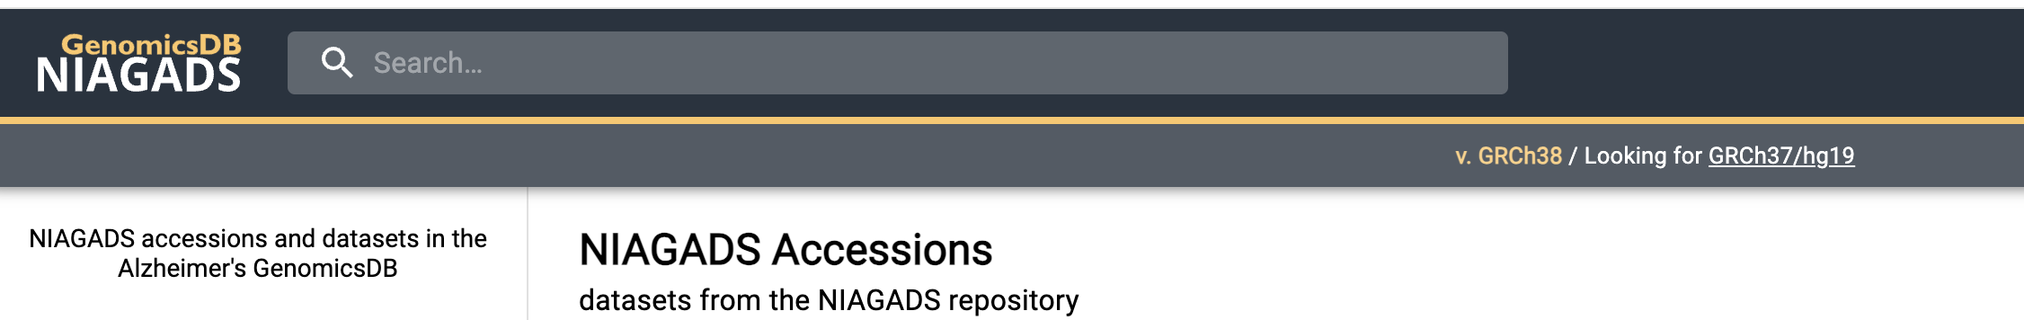

GWAS catalogs
www.ebi.ac.uk/gwas/downloads/summary-statistics
www.niagads.org/genomics/app/record/dataset/accessions
pgc.unc.edu/for-researchers/download-results/

Slide 34



Acknowledgements

Slide 35
Practical Session

Slide 36
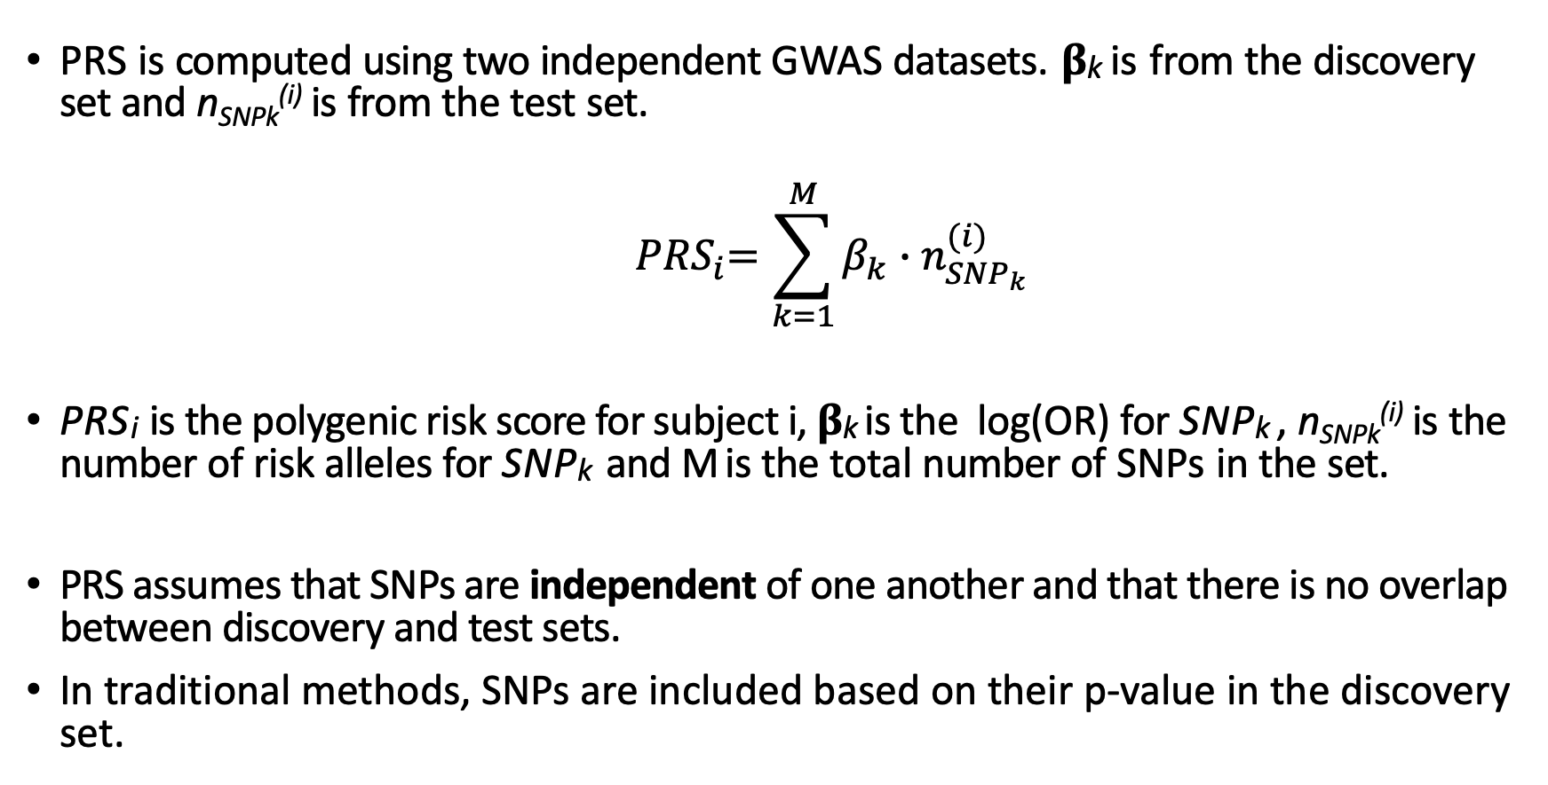
PRS
PRS is computed using two independent GWAS datasets. 𝛃_{k} is from the discovery set and n_{SNPk}^{(i)} is from the test set.
$${ PRS}_{i}=\sum_{k=1}^{M}{β_{k}∙n_{{SNP}_{k}}^{(i)}}$$
PRS_{i} is the polygenic risk score for subject i, 𝛃_{k} is the log(OR) for SNP_{k} , n_{SNPk}^{(i)} is the number of risk alleles for SNP_{k} and M is the total number of SNPs in the set.
PRS assumes that SNPs are independent of one another and that there is no overlap between discovery and test sets.
In traditional methods, SNPs are included based on their p-value in the discovery set.
Notes:
𝛃𝛃

Slide 37
PRS
SNP | BETA | P-value
SNP1 | 1 | 0.001
SNP2 | 0.5 | 0.05
SNP3 | 0.001 | 0.1
… | …
SNPM | -2 | 0.0001
Discovery data
(GWAS summary stats)
Individual ID | SNP1 | SNP2 | SNP3 | … | SNPM
ID1 | 1 | 2 | 0 | … | 2
ID2 | 0 | 0 | 2 | … | 0
ID3 | 0 | 1 | 1 | … | 0
… | … | … | … | … | …
IDN | 2 | 2 | 1 | … | 1
Test data
(Genotype data)
PRS_{ID 1} = 1 × 1 + 0.5 × 2 + 0.001 × 0 + ... + −2 × 2
PRSNorm_{ID1} = (PRS_{ID1 –} mean(PRS)) / sd(PRS)

Slide 38
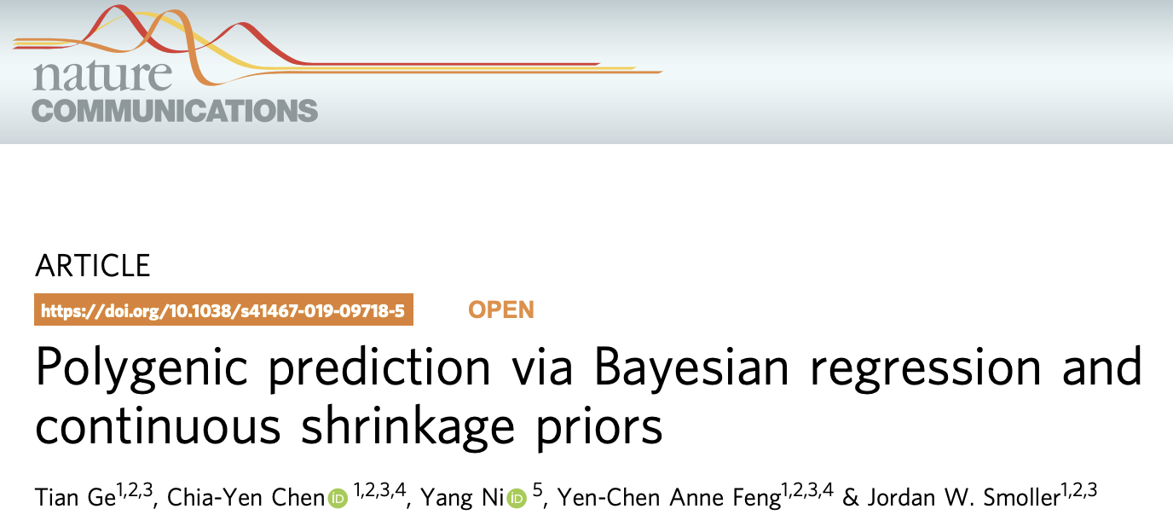
PRS-CS
PRS-CS infers posterior SNP effect sizes under continuous shrinkage (CS) priors using GWAS summary statistics and an external LD reference panel.
PRS-CS adjusts the effect sizes based on their association signal and LD between markers
These effect sizes are used in place of those directly from the AD GWAS.

Slide 39
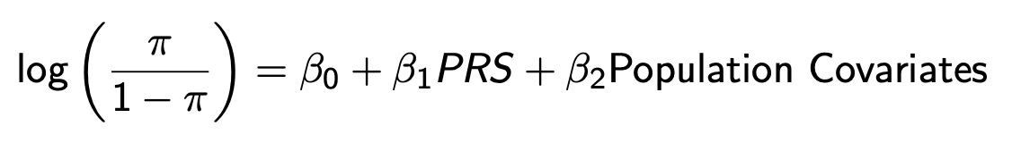
Logistic Regression
Logistic regression is used to test the association between a binary trait (such as case/control status) and PRS.
Other population covariates can be adjusted for.
𝛃₁ is the log(OR) for the effect of PRS on the phenotype.

Slide 40
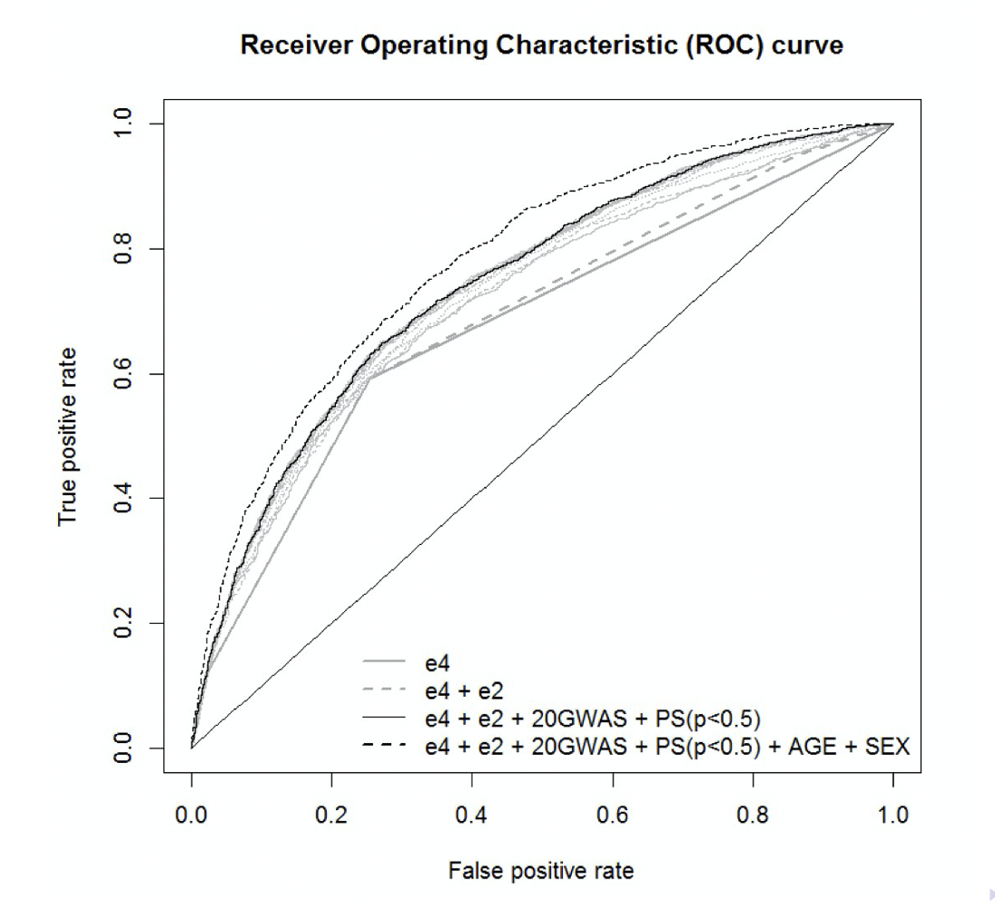
AUC
Area under the receiver operating curve is a measure of the predictive accuracy of a model.
AUC = 1 is perfect prediction accuracy
i.e. you correctly assign each case and control
AUC = 0.5 suggests an uninformative model
i.e. cases and controls are randomly assigned

Slide 41
Stepwise Regression
Stepwise regression is a method which automatically optimises a regression model by selecting the combination of variables which explain the most variability in the phenotype.
The selection of variables from stepwise regression should enable the best prediction of the phenotype.

Slide 42
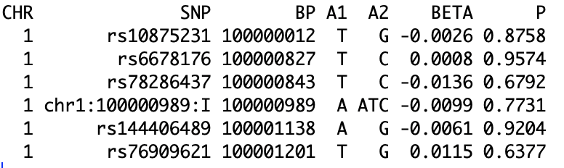
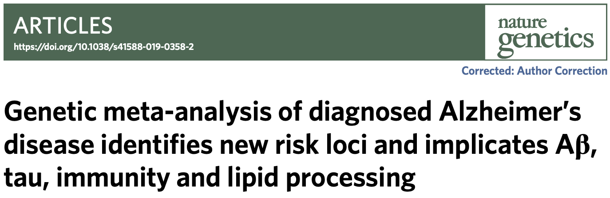
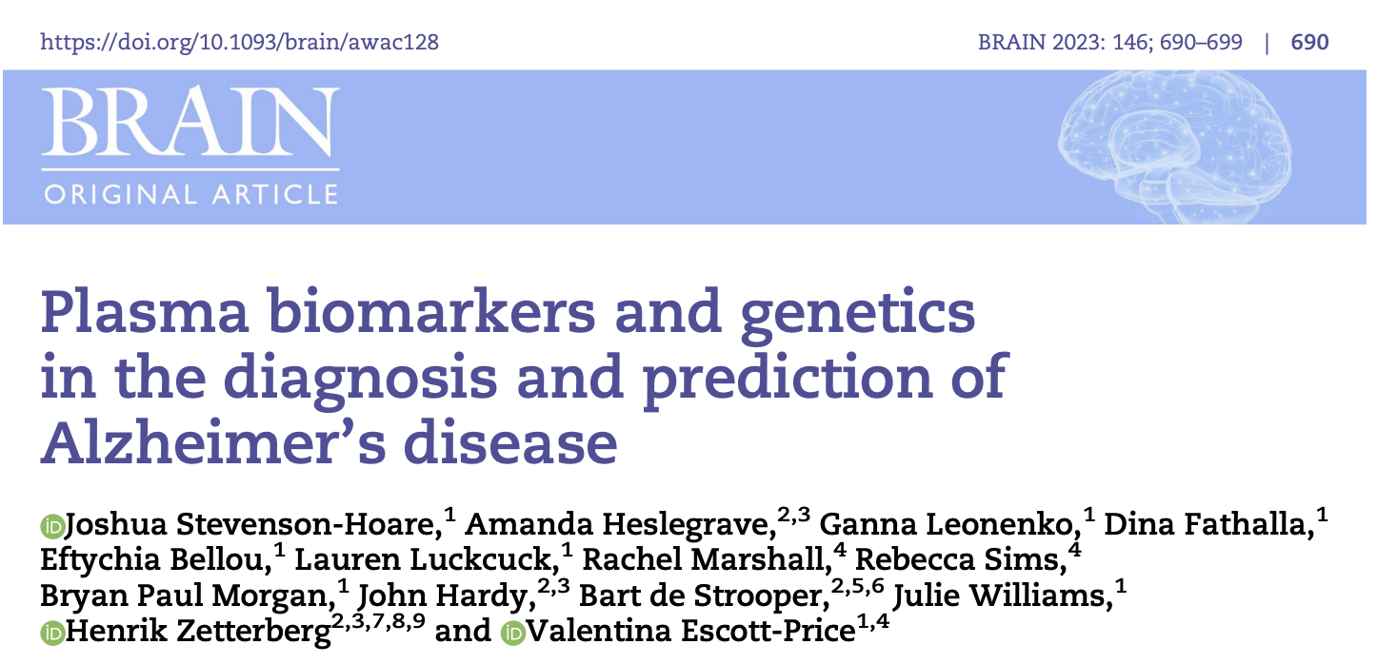
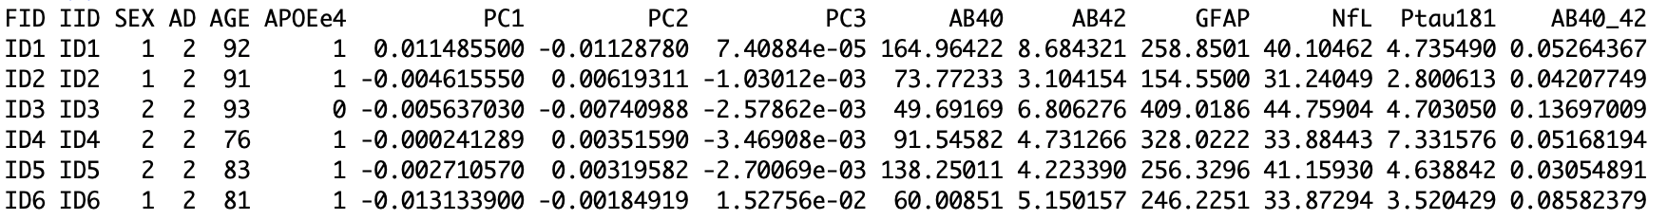
Practical Data
Summary statistic data is a published AD GWAS by Kunkle et al.
Genotype data was simulated. 10,000 cases, 10,000 controls with 20,000 causal SNPs (effect sizes taken from Kunkle, SNPs with p < 0.3) including 21 SNPs known to be associated with AD and 180,000 random SNPs (again from Kunkle with p > 0.3)
Covariates were simulated. Sex was randomly assigned. Age was taken from a Normal distribution with mean = 85 and SD = 5 in cases and mean = 80 and SD = 20 in controls.
Biomarkers were simulated based on mean and SD of values in cases and controls in BRAIN paper.

Slide 43
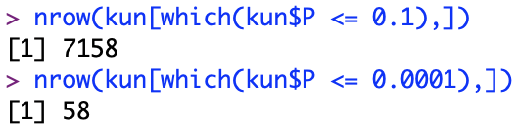
Compute PRS (using PRS(C+T))
Clump the data, using r2 threshold of 0.1 and 1000kb window.
Threshold the summary statistics, use two thresholds, 0.1 and 0.0001
Compute the PRS score

Slide 44
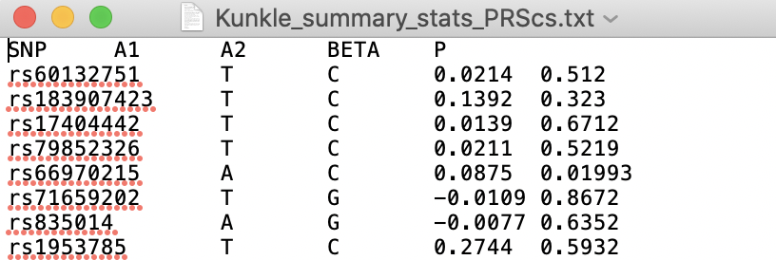
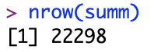
Compute PRS (using PRS-CS)
Output summary stats in the correct format
Run PRS-CS with default parameters
Compute score
python /home/training/PRScs/PRScs.py --ref_dir /home/training/PRScs/ldblk_ukbb_eur --bim_prefix=AD_GWAS_data_final --sst_file=Kunkle_summary_stats_PRScs.txt --n_gwas=63926 --out_dir=Kunkle_PRScs_weights

Slide 45
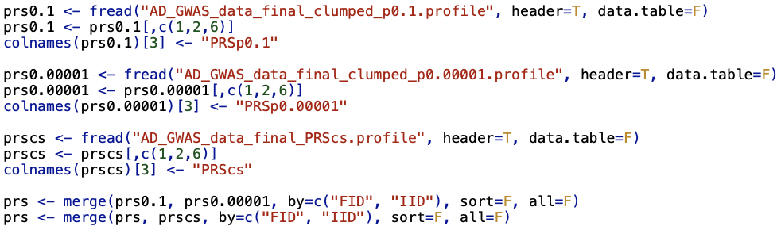
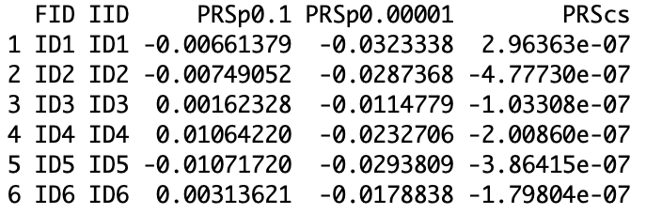
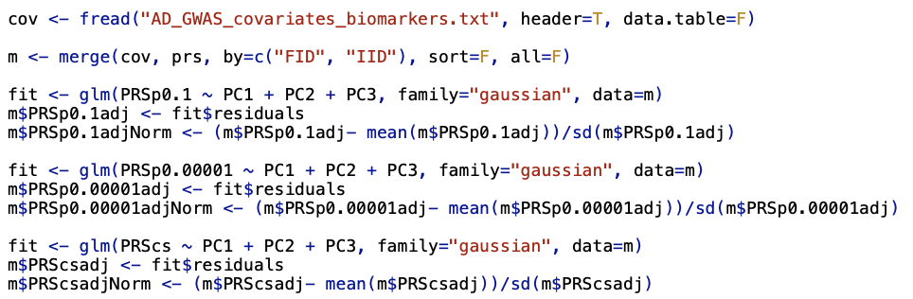
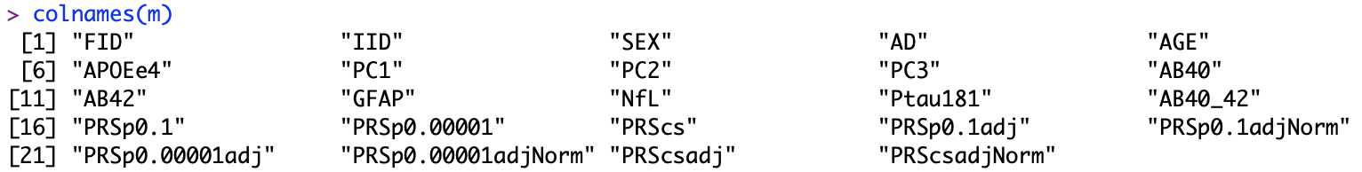
Merge PRS data and covariates
Merge all PRS files
Adjust PRS for principal components and normalise

Slide 46
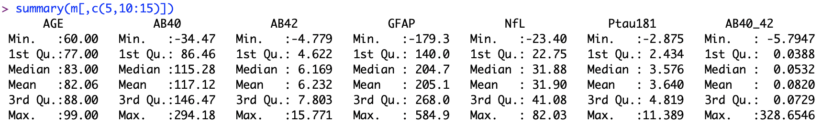
Descriptive Statistics of Covariates
Look at descriptive statistics for covariates and biomarkers

Slide 47
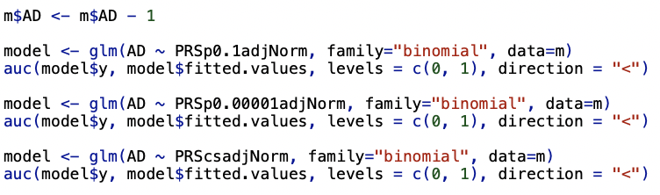
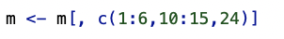
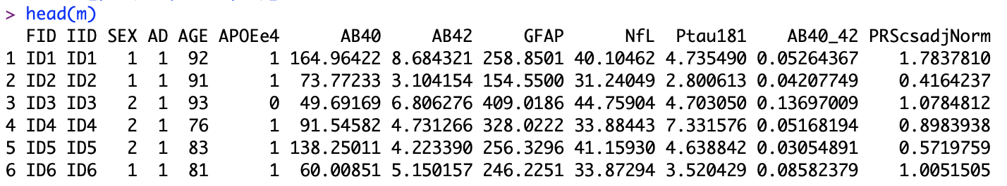
Prediction Accuracy of PRS
Find the AUC for each of the three computed PRSes
Keep the most predictive PRS
AUC= 0.5317, 0.5887, 0.6341

Slide 48
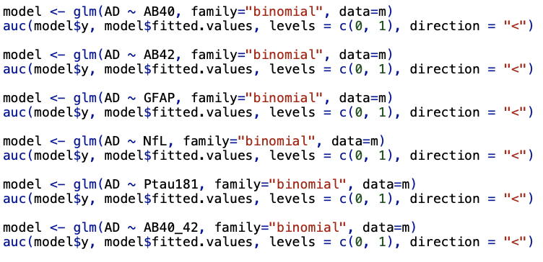
Prediction Accuracy of Biomarkers
Find the AUC for the 6 available biomarkers (AB40, AB42, GFAP, NfL, Ptau181 and AB40/AB42)
AUC=
0.8072,
0.818,
0.5624,
0.5388,
0.6471,
0.5094

Slide 49
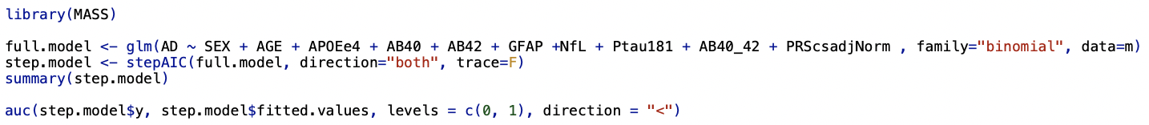
Stepwise Regression
Use stepwise regression to find the optimal combination of covariates to best predict AD
AUC for stepwise model = 0.9362

Slide 50
Extras: Compute PRS without APOE region
Remove APOE region from summary stats (chr19: 44.4-46.5Mb)
Compute PRS-CS on sum stats without APOE
Compute PRS
126 SNPs removed
python /home/training/PRScs/PRScs.py --ref_dir /home/training/PRScs/ldblk_ukbb_eur --bim_prefix=AD_GWAS_data_final --sst_file=Kunkle_noAPOE_summary_stats_PRScs.txt --n_gwas=63926 --out_dir=Kunkle_noAPOE_PRScs_weights

Slide 51
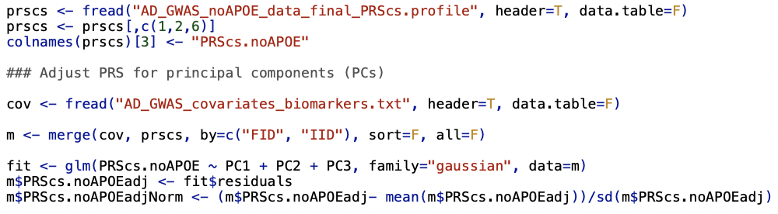
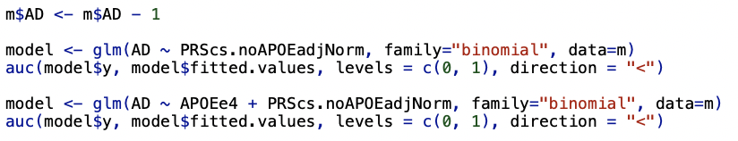
Prediction Accuracy of PRS.no.APOE + APOEe4
Adjust PRS for PCs and normalise
Find AUC for PRS.noAPOE, and then AUC for APOEe4 + PRS.noAPOE
AUC PRS.noAPOE = 0.6255
AUC for APOEe4 + PRS.noAPOE = 0.7225
AUC for PRS (which includes APOE) = 0.6341

